Slide 1
coursebrew
an instructor-course
assignment application
Sponsor & Faculty Advisor
Dr. C. Rich Compeau
Texas State University
Ingram School of Engineering
Team Members David Johnson, Kiana McDaniel, Phillip Tran

Slide 2



Instructor-Course Assignment
twice a year instructors are assigned to the courses they are teaching for each semester

Slide 3

The dreaded excel spreadsheet
hard to navigate
hard to manage
non-concurrent users

Slide 4

Let’s make this process better with coursebrew
intuitive and easy to use
web-based
concurrent users
expandable

Slide 5




Features
add course/instructor
edit course/instructor
assignment recommendation
warning generation
PDF export

Slide 6
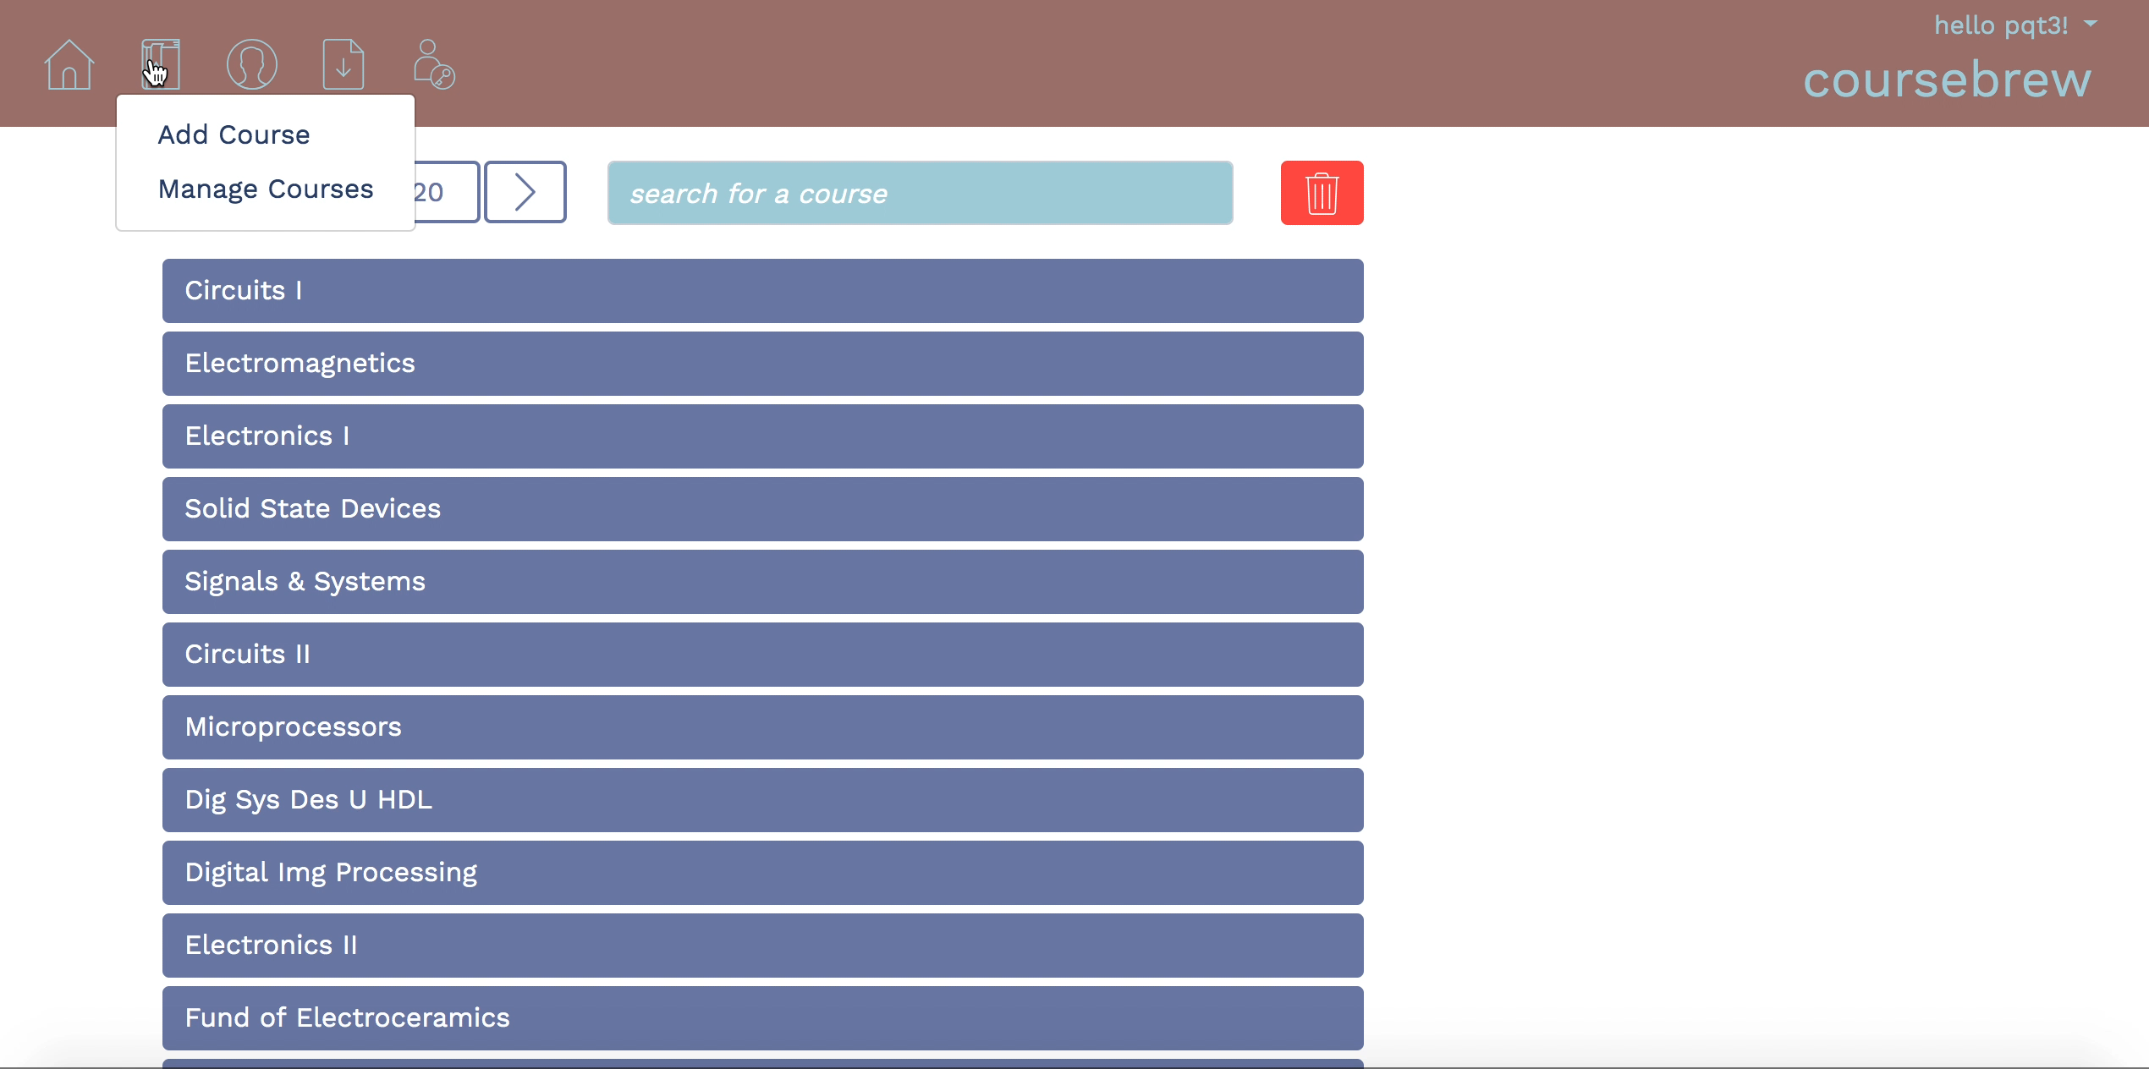

Slide 7



Expandability
coursebrew is designed to be scalable, manageable, and modular

Slide 8



Implementation
FRONTEND
BACKEND
DATA STORAGE

Slide 9

Performance
low latency ~ avg. 38ms
low memory usage ~ avg. 42.8MB
42.8MB
38ms

Slide 10
Future work
security
log in system
improved assignment recommendation
automatic assignment
class scheduling (time, room)
analytics
Lessons learned
don’t rely on outside software
interfaces
start with a complete database
schema

Slide 11
A BIG THANK YOU!
Dr. Compeau (Sponsor & Faculty Advisor)
Mr. Hinkle (Instructor)
Dr. McClellan (Faculty Advisor)
thank you so much for your guidance throughout the semester. we really appreciate it!

